Slide 1
Oracle Database 12c: SQL Workshop I
Student Guide – Volume II

Slide 2
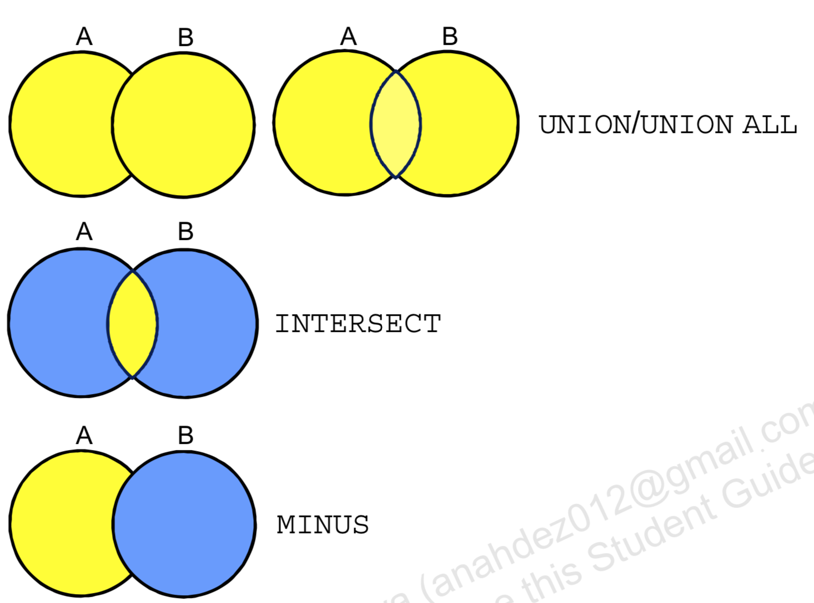
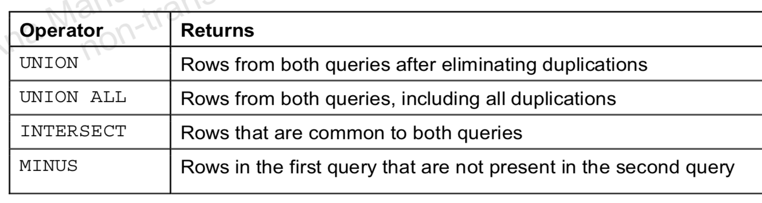
Set Operators

Slide 3
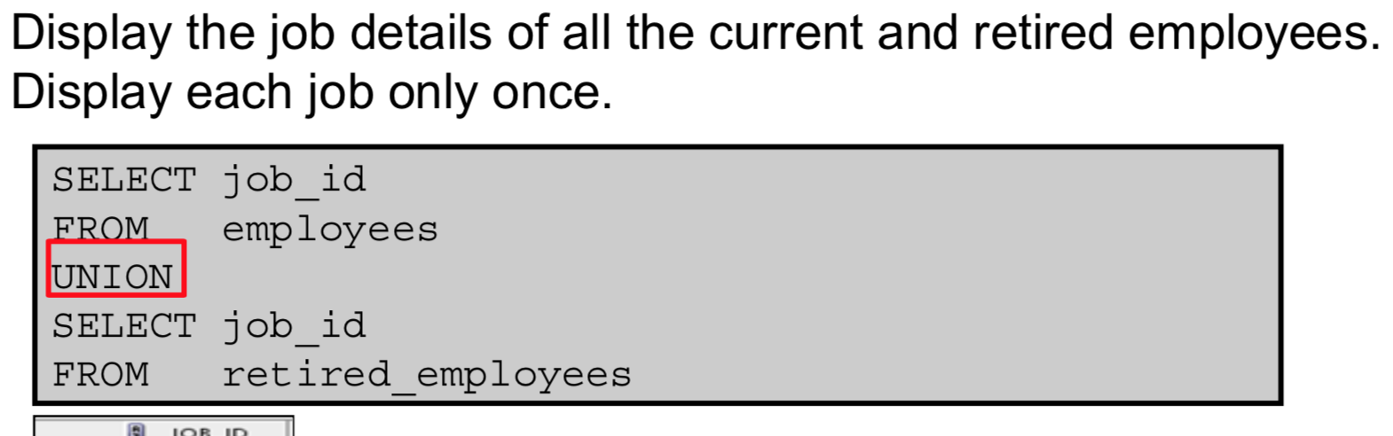
Using the UNION Operator

Slide 4
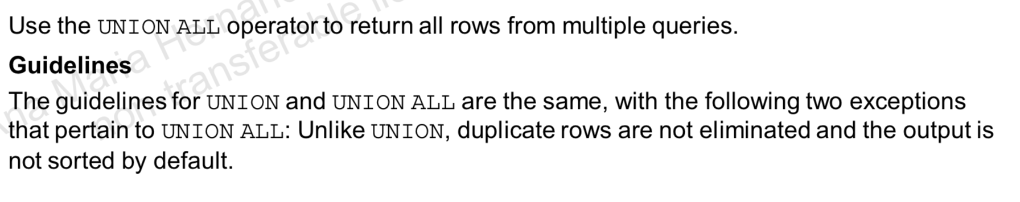
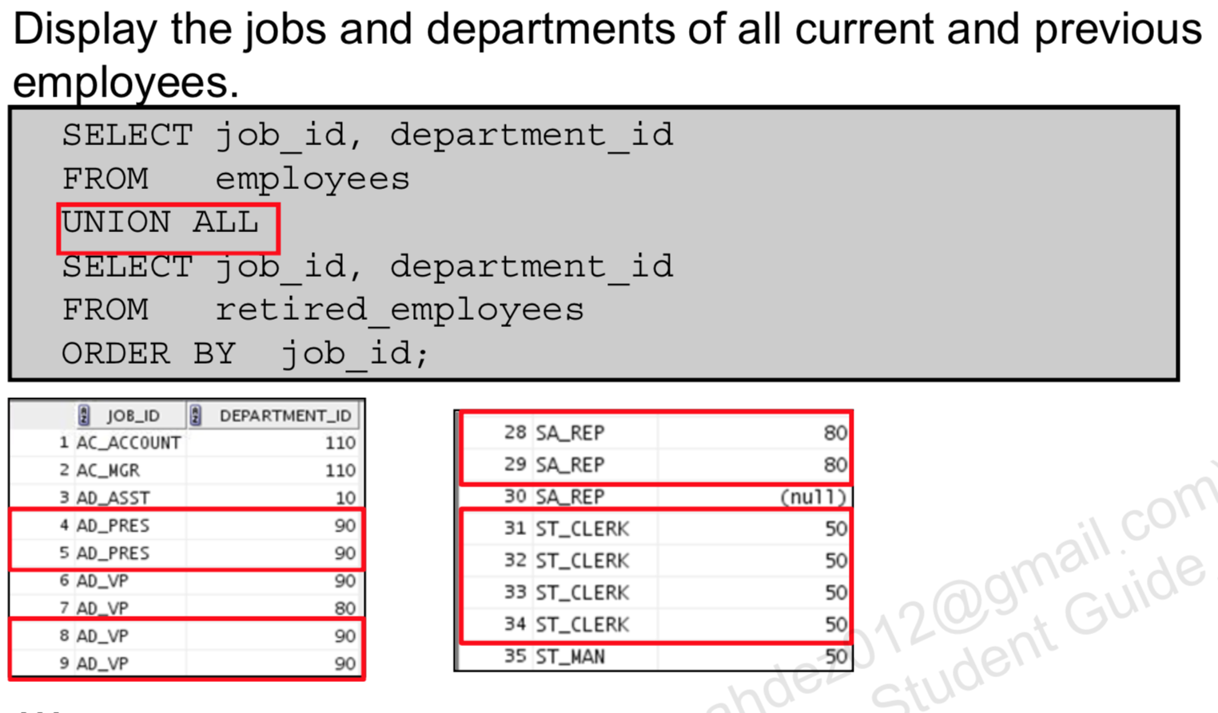
UNION ALL Operator

Slide 5
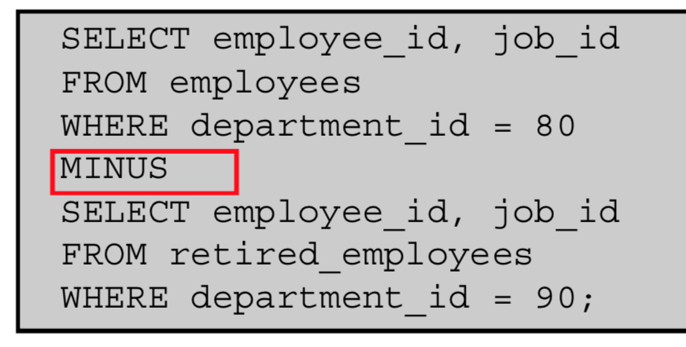
Using the MINUS Operator
Display the employee IDs and Job IDs of those employees who
works in the sales department.

Slide 6
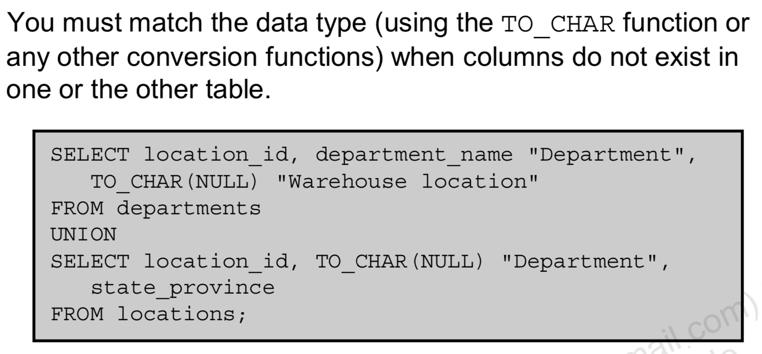
Matching SELECT Statements

Slide 7
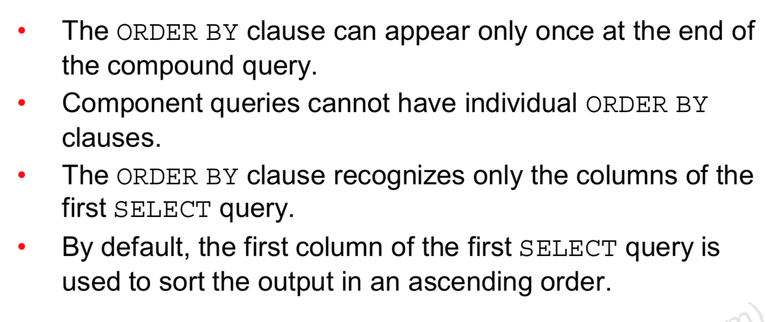
Using the ORDER BY Clause in Set Operations

Slide 8

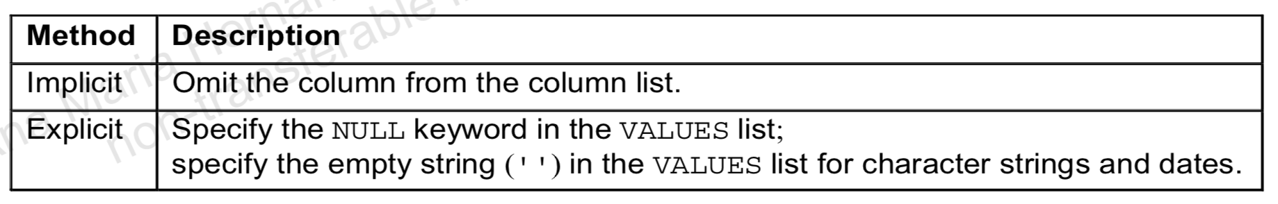
Data Manipulation Language
A DML statement is executed when you:
– Add new rows to a table
– Modify existing rows in a table
– Remove existing rows from a table
A transaction consists of a collection of DML statements that form a logical unit of work.

Slide 9
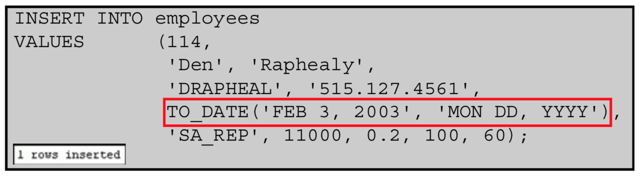
Inserting Specific Date and Time Values

Slide 10
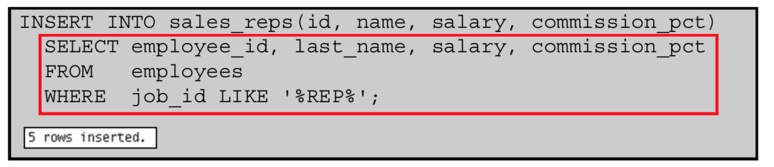
Copying Rows from Another Table

Slide 11
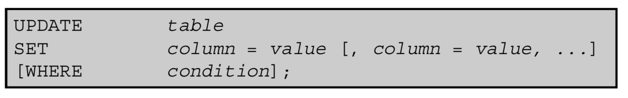
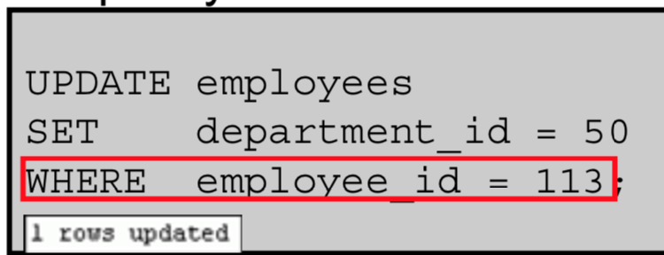
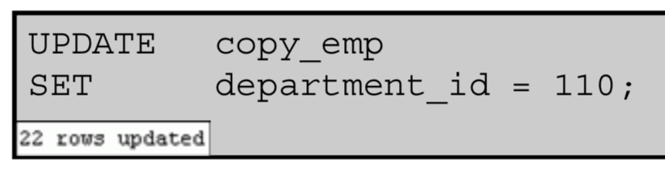
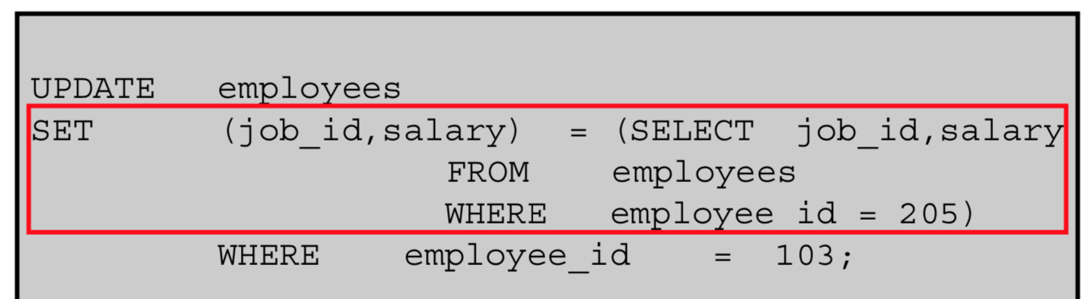
UPDATE Statement Syntax

Slide 12
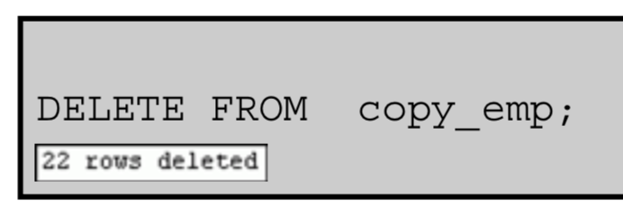
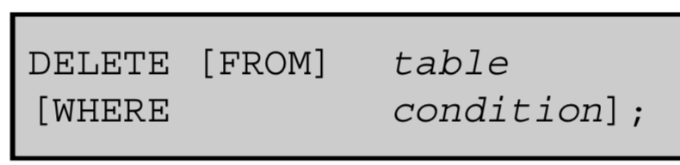
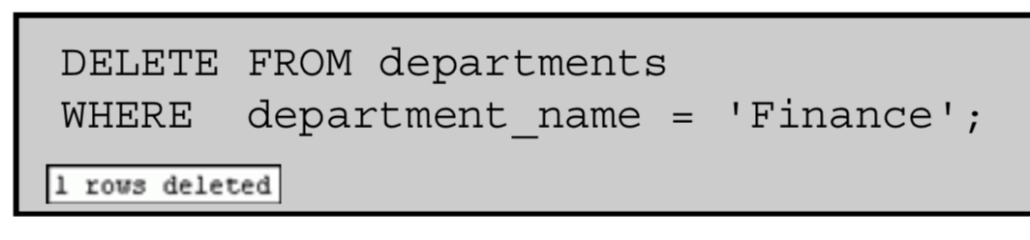
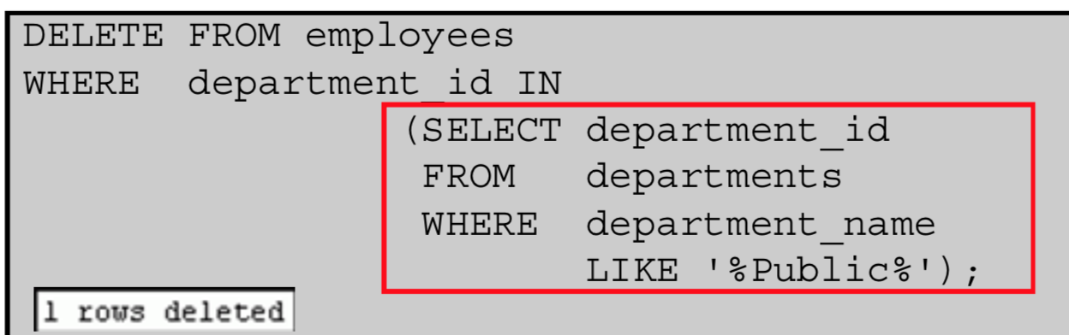
Removing a Row from a Table

Slide 13
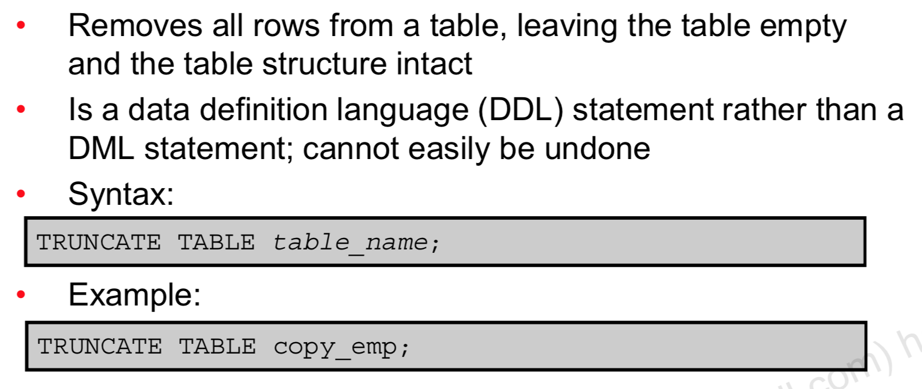
TRUNCATE Statement

Slide 14
Advantages of COMMIT and ROLLBACK Statements
With COMMIT and ROLLBACK statements, you can:
Ensure data consistency
Preview data changes before making changes permanent
Group logically related operations

Slide 15
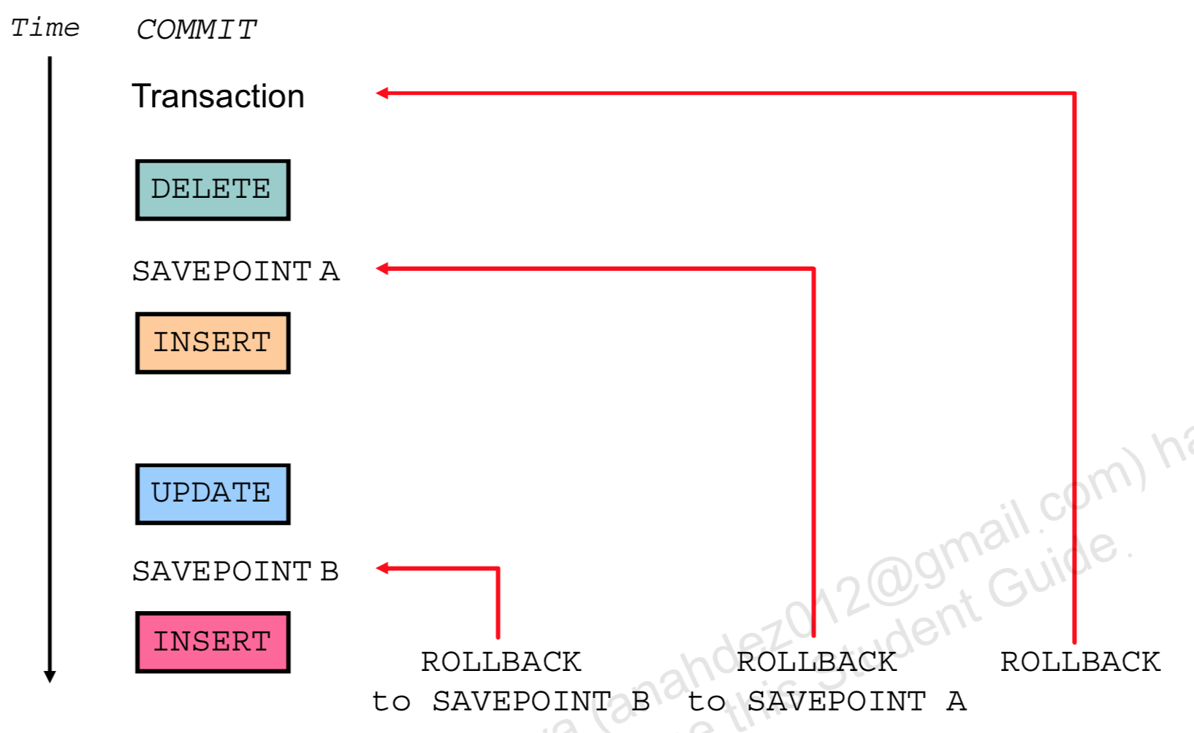
Explicit Transaction Control Statements

Slide 16
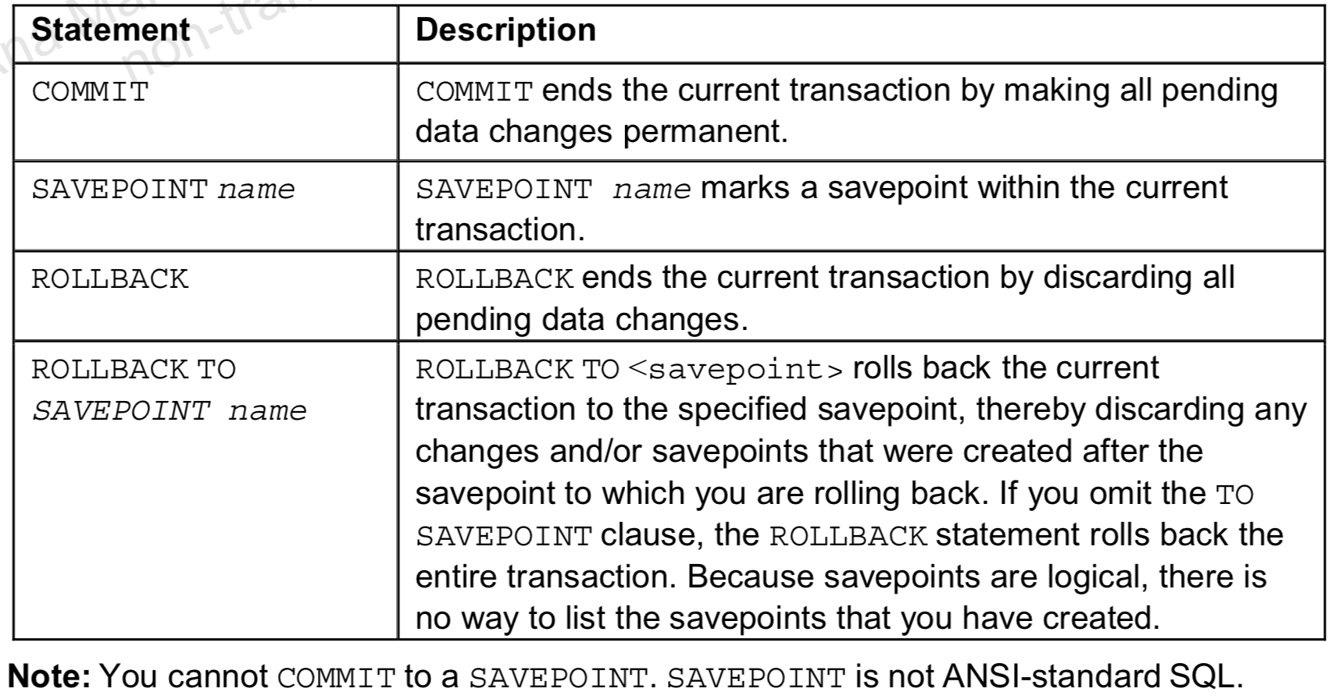
Control the logic of transactions by using the COMMIT, SAVEPOINT, and ROLLBACK

Slide 17
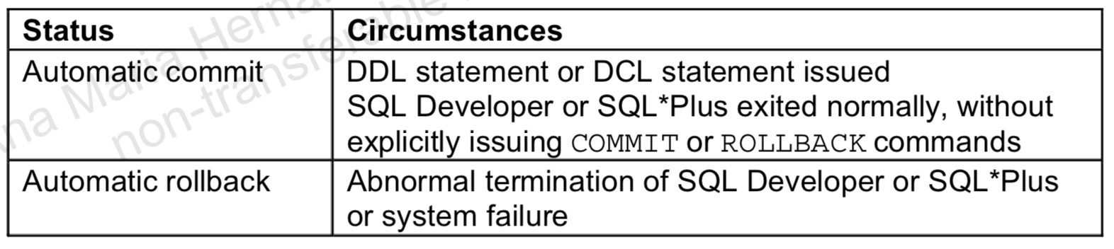
Implicit Transaction Processing

Slide 18
State of Data Before COMMIT or ROLLBACK
The previous state of the data can be recovered.
The current session can review the results of the DML operations by using the SELECT statement.
Other sessions cannot view the results of the DML statements issued by the current session.
The affected rows are locked; other session cannot change the data in the affected rows.

Slide 19
State of Data After COMMIT
Data changes are saved in the database.
The previous state of the data is overwritten.
All sessions can view the results.
Locks on the affected rows are released; those rows are available for other sessions to manipulate.
All savepoints are erased.

Slide 20
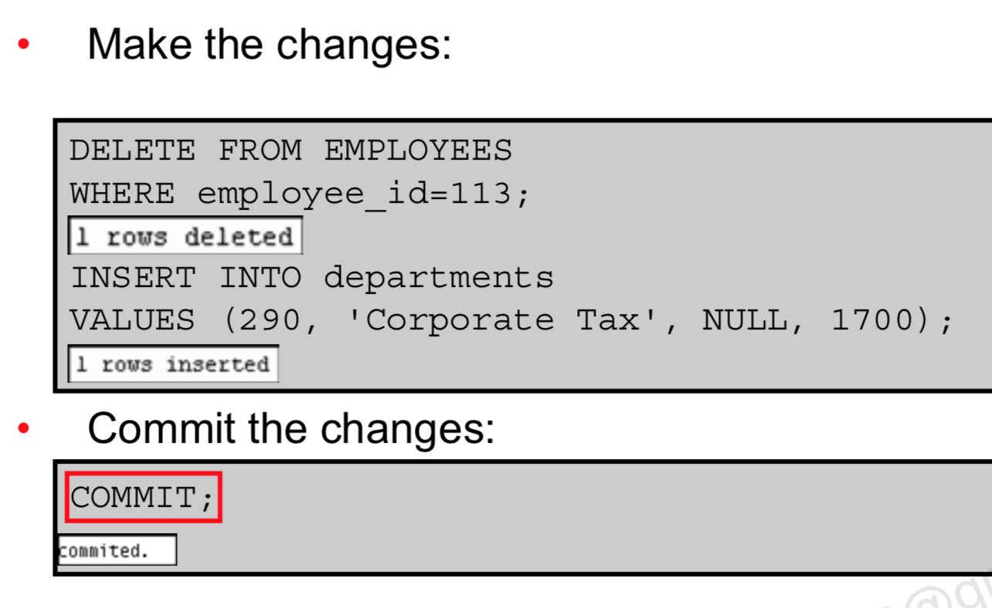
Committing Data

Slide 21
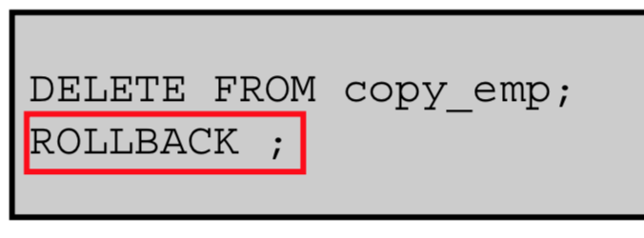
State of Data After ROLLBACK
Discard all pending changes by using the ROLLBACK statement:
Data changes are undone.
Previous state of the data is restored.
Locks on the affected rows are released.
DELETE FROM test;
SELECT * FROM test;
ROLLBACK;
DELETE FROM test WHERE id = 100;
SELECT * FROM test WHERE id = 100;
COMMIT;

Slide 22
Read Consistency
Read consistency guarantees a consistent view of the data at all times.
Changes made by one user do not conflict with the changes made by another user.
Read consistency ensures that, on the same data:
– Readers do not wait for writers
– Writers do not wait for readers
– Writers wait for writers
Read operations (SELECT statement)
Write operations (INSERT, UPDATE, DELETE statements)

Slide 23
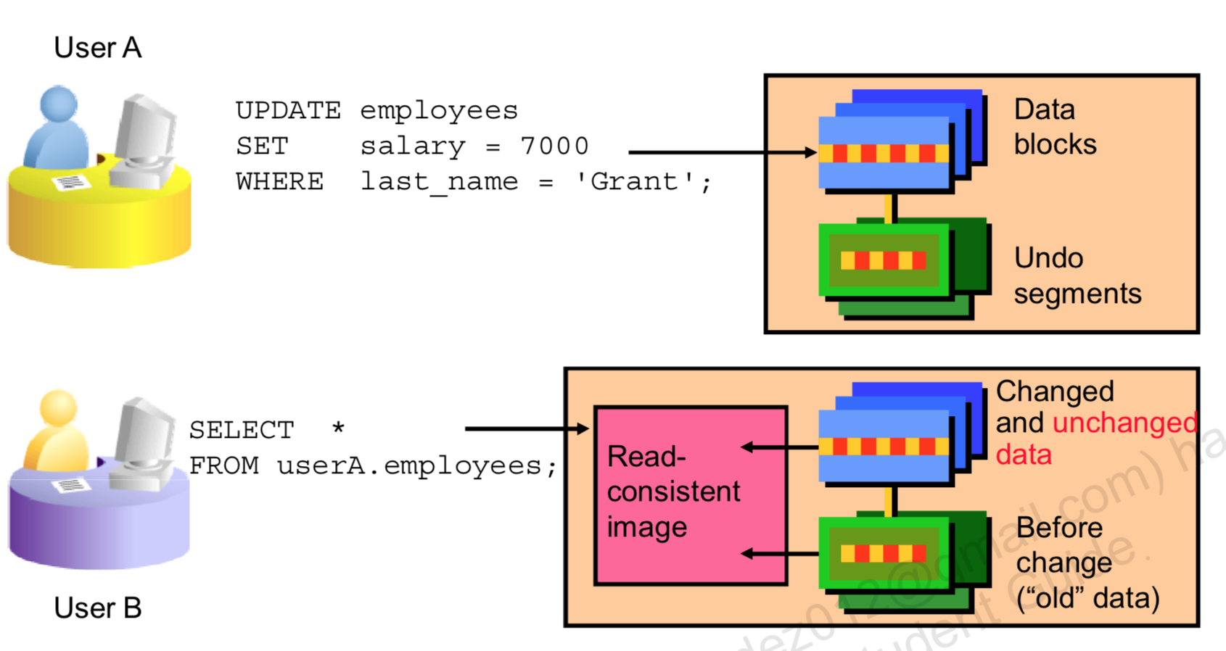
Implementing Read Consistency

Slide 24
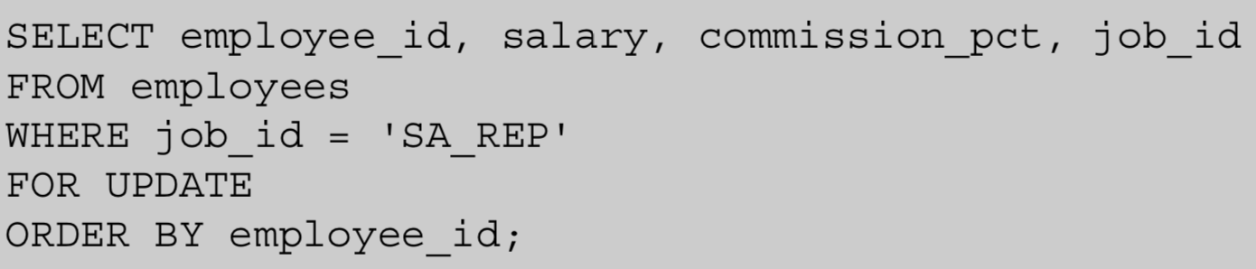
FOR UPDATE Clause in a SELECT Statement
Locks the rows in the EMPLOYEES table where job_id is SA_REP.
Lock is released only when you issue a ROLLBACK or a COMMIT.
If the SELECT statement attempts to lock a row that is locked by another user, the database waits until the row is available, and then returns the results of the SELECT statement.

Slide 25
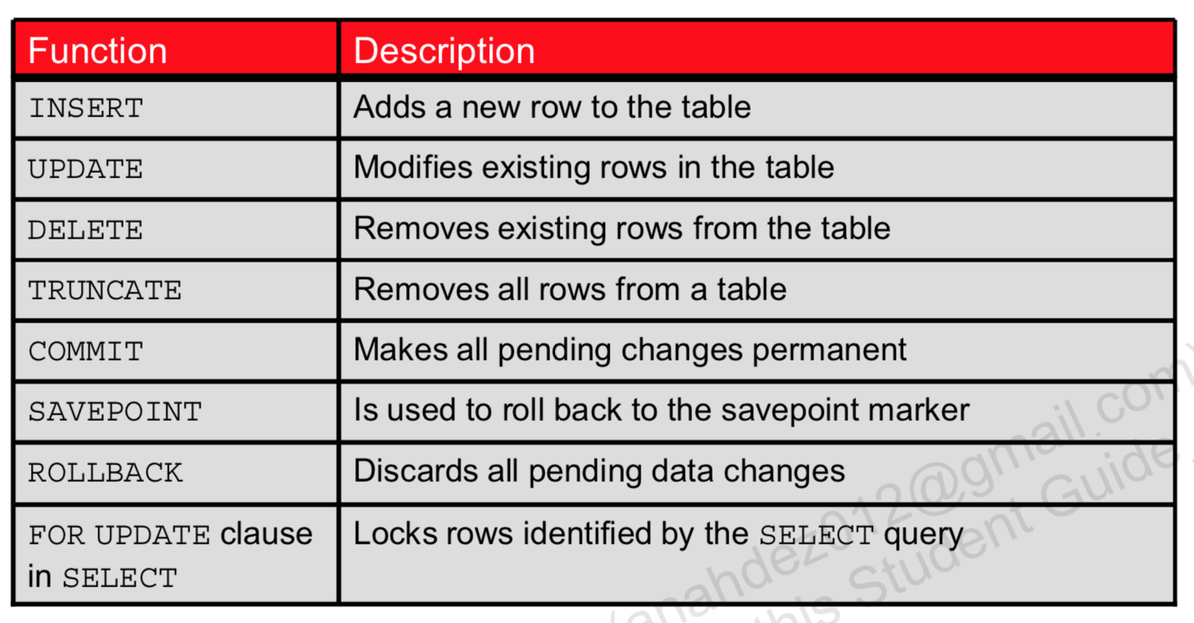
Summary

Slide 26
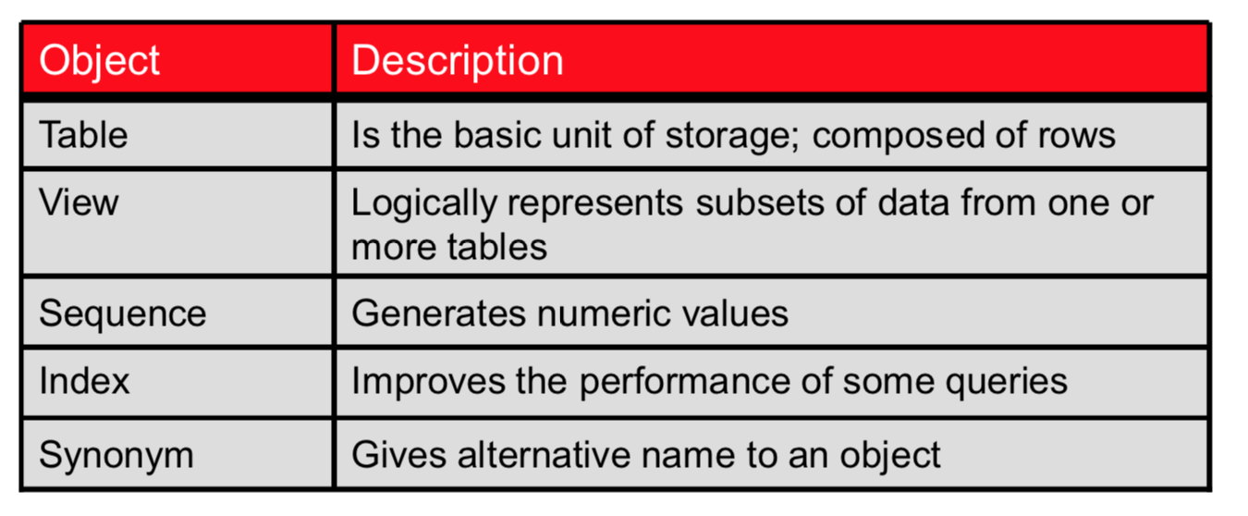
Database Objects
Table names and column names must:
Begin with a letter
*Be 1–30 characters long
Contain only A–Z, a–z, 0–9, _, $, and #
Not duplicate the name of another object owned by the same user
Not be an Oracle server–reserved word

Slide 27
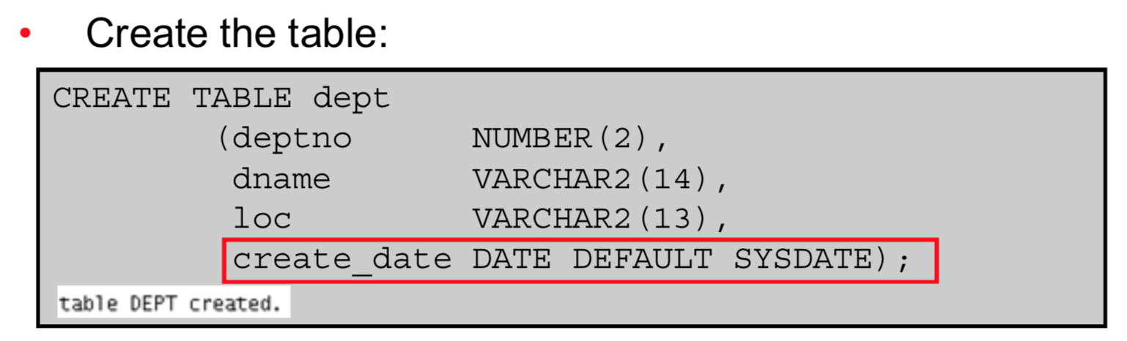
CREATE TABLE Statement

Slide 28
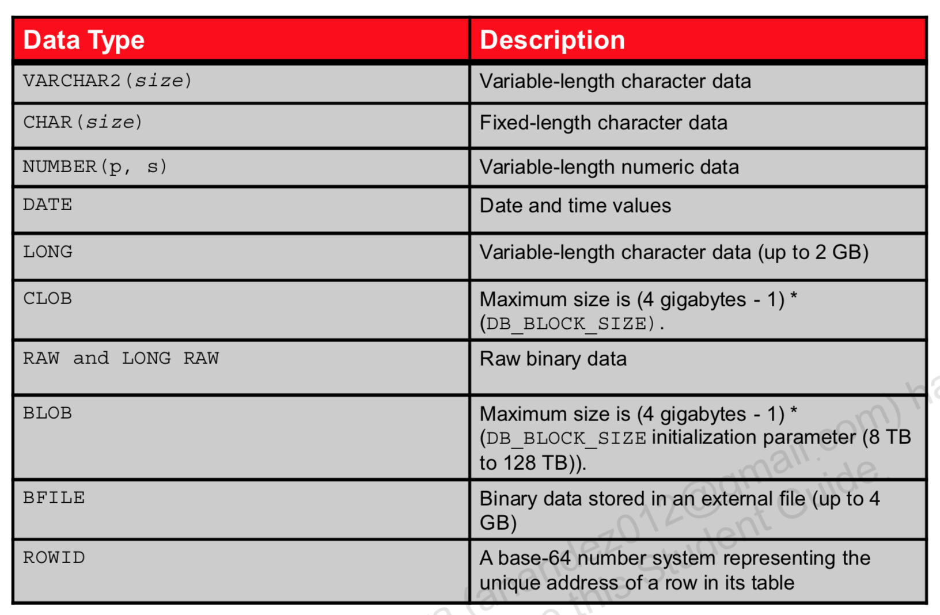
Data Types

Slide 29
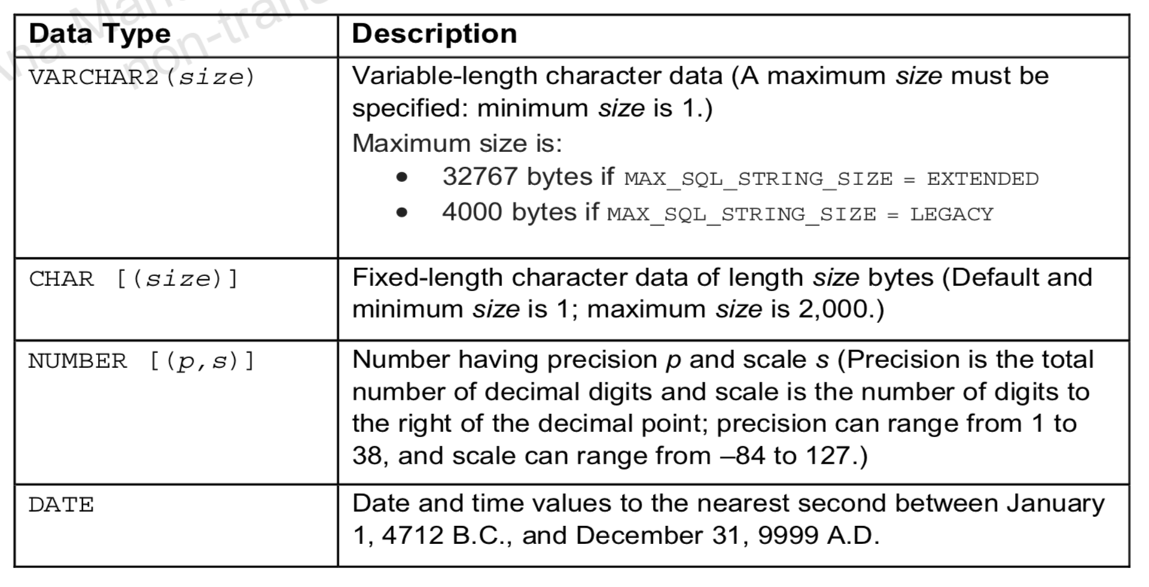
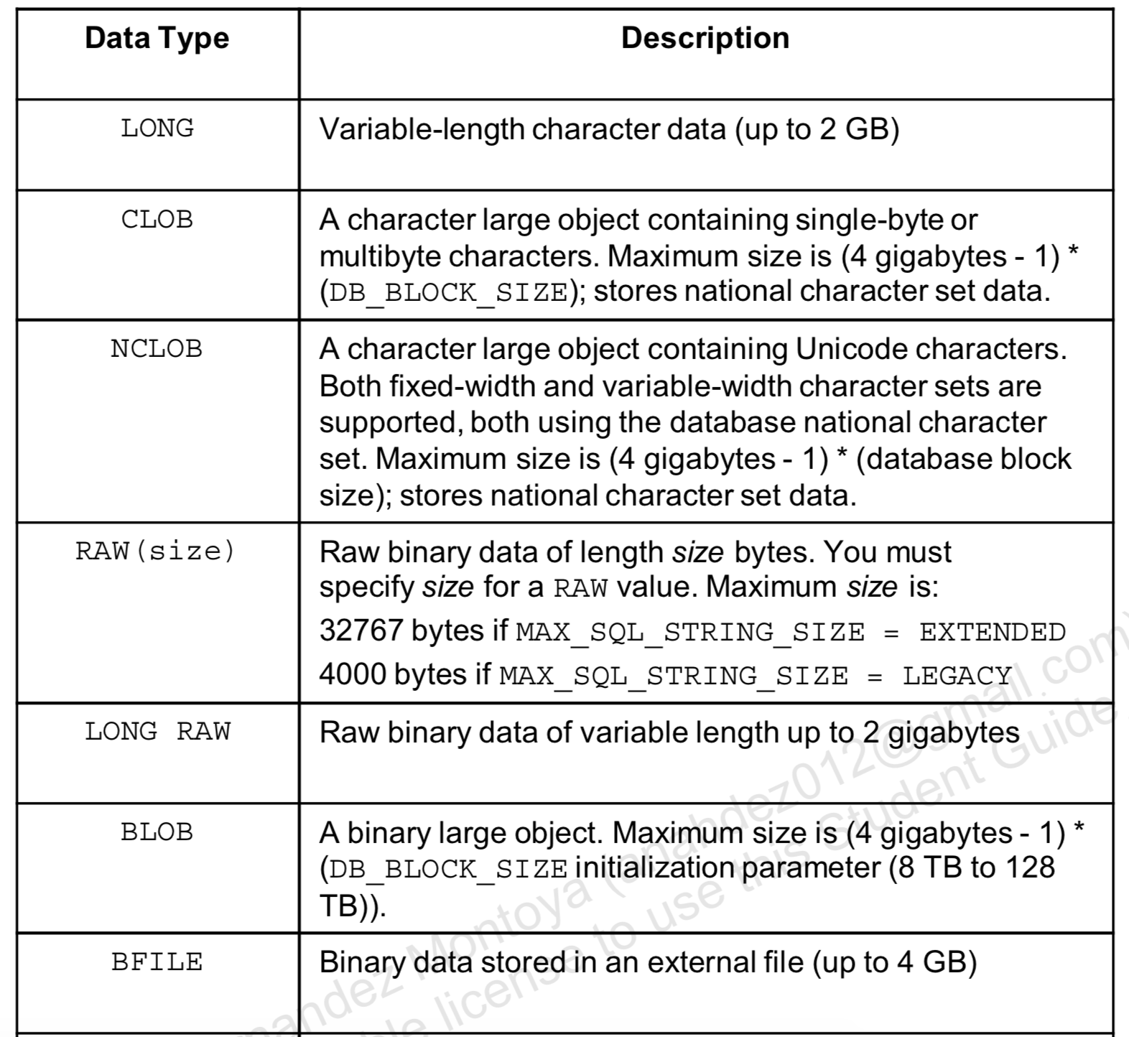
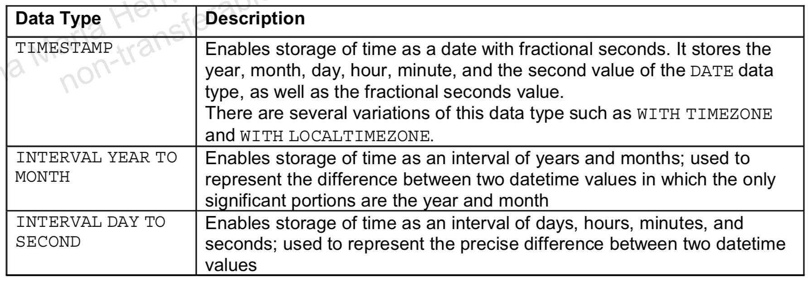
Data Types

Slide 30
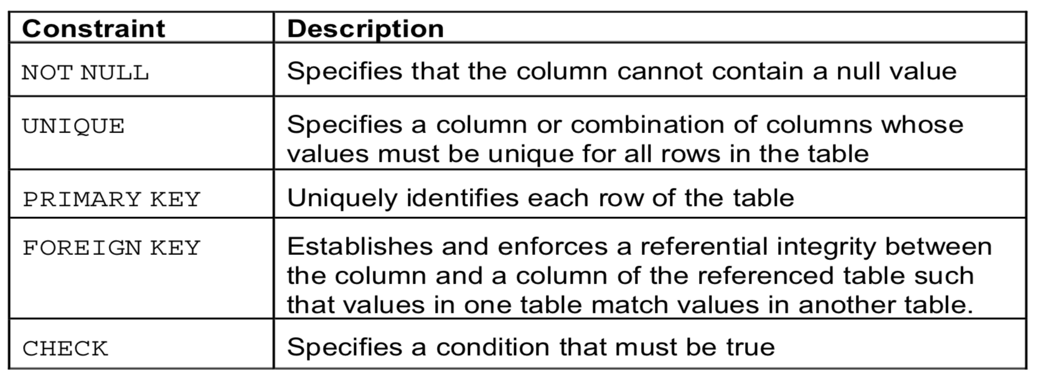
Data Integrity Constraints

Slide 31
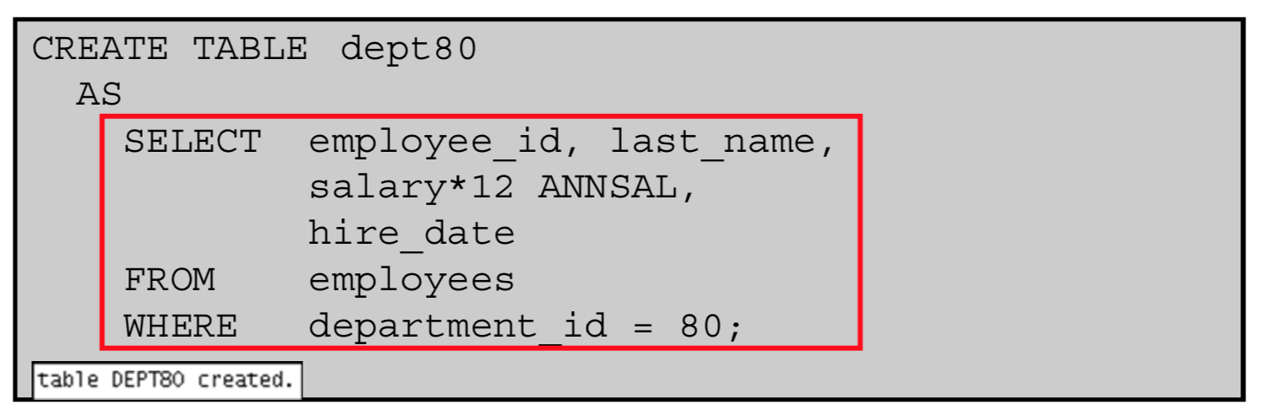
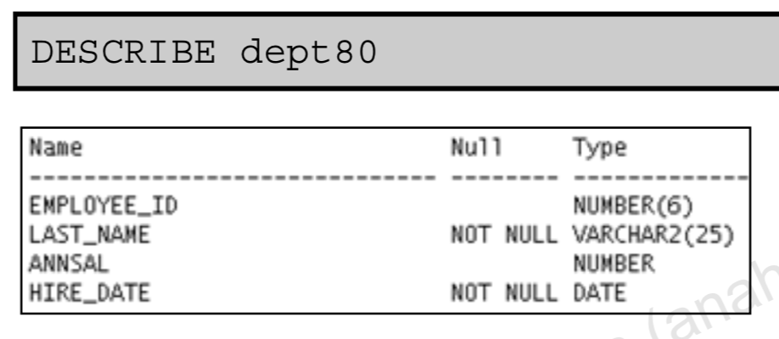
Creating a Table Using a Subquery

Slide 32
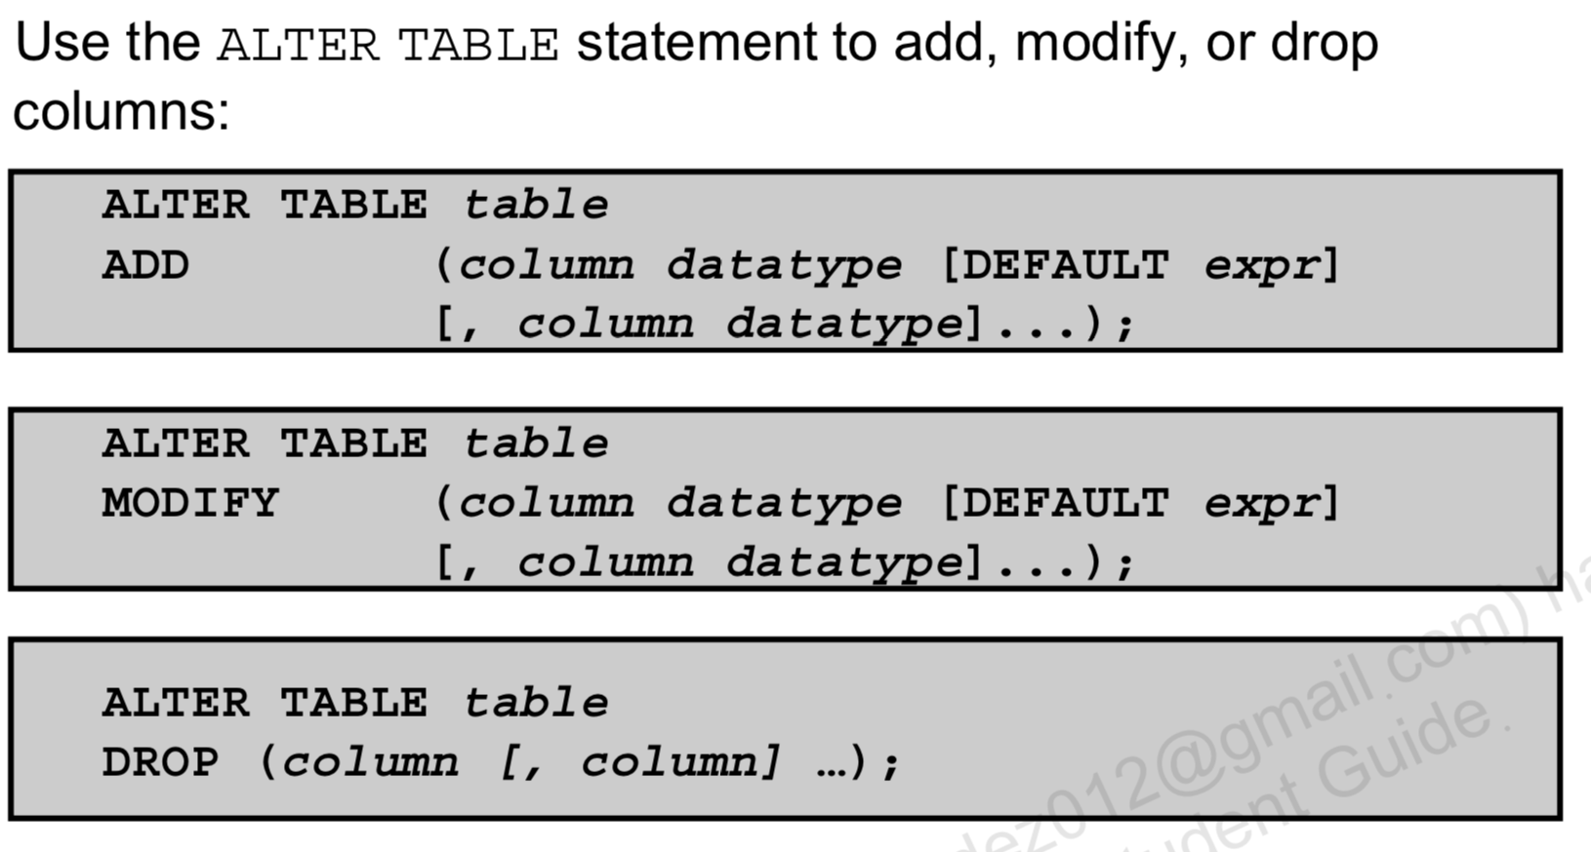
ALTER TABLE Statement

Slide 33
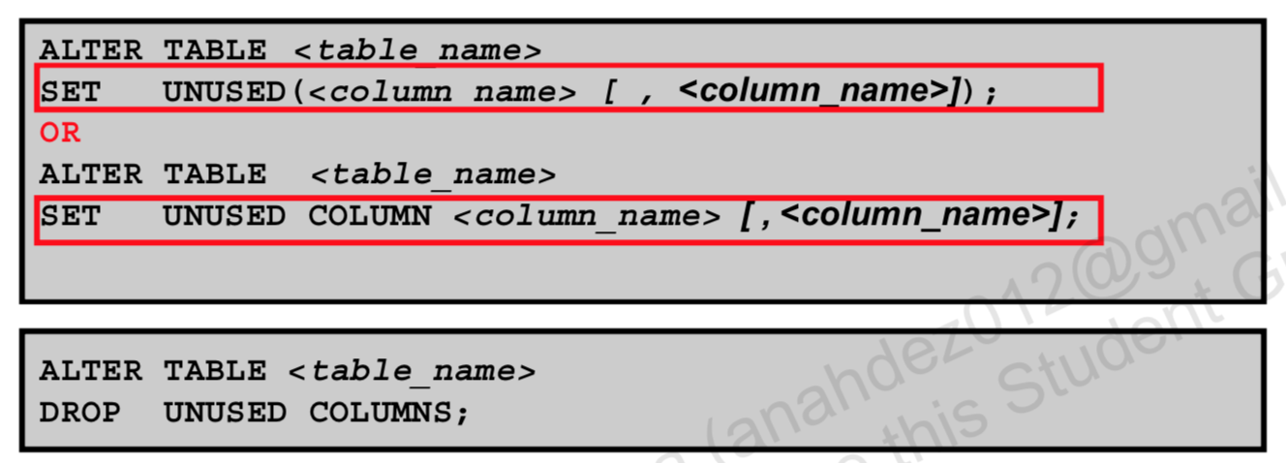
SET UNUSED Option
You use the SET UNUSED option to mark one or more columns as unused.
You use the DROP UNUSED COLUMNS option to remove the columns that are marked as unused.
You can specify the ONLINE keyword to indicate that DML operations on the table will be allowed while marking the column or columns UNUSED.

Slide 34
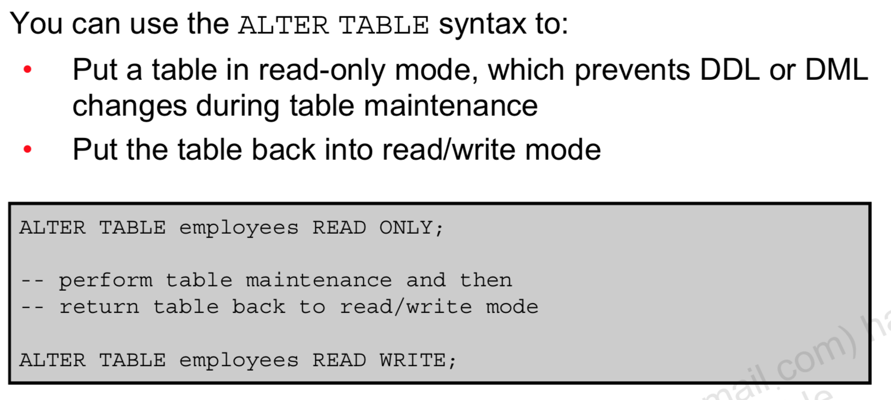
Read-Only Tables

Slide 35
Dropping a Table
Moves a table to the recycle bin
Removes the table and all its data entirely if the PURGE
clause is specified
Invalidates dependent objects and removes object privileges on the table
DROP TABLE dept80;
DROP TABLE table [PURGE]
Use the FLASHBACK TABLE statement to restore a dropped table from the recycle bin.

